Slide 1



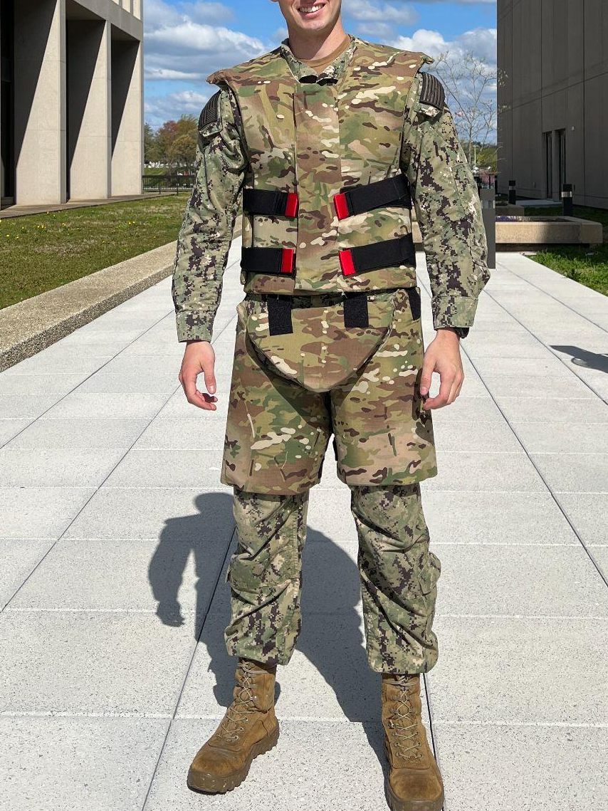
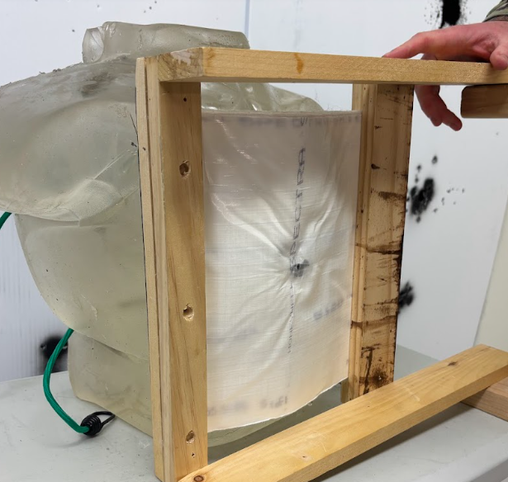
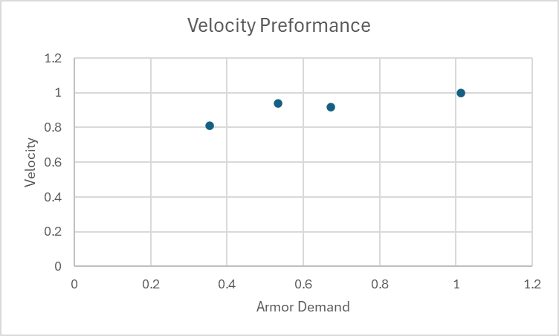
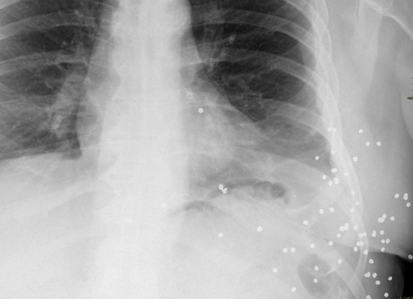
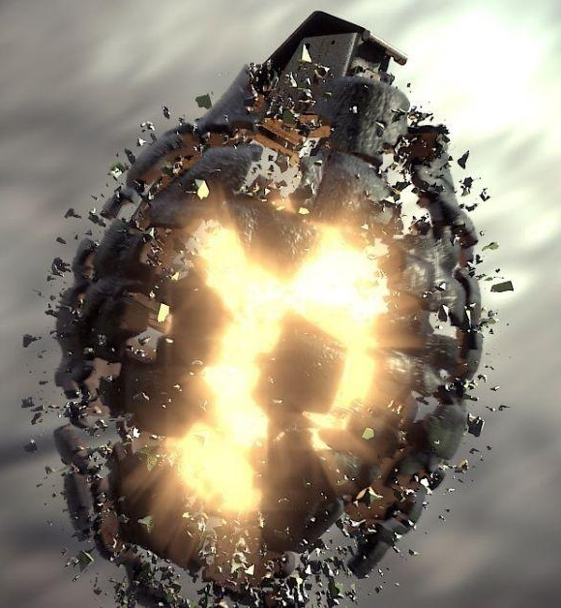
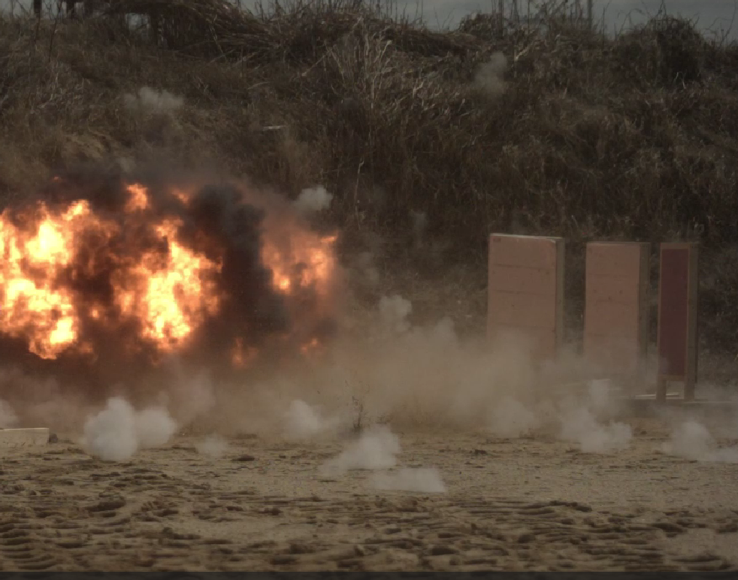
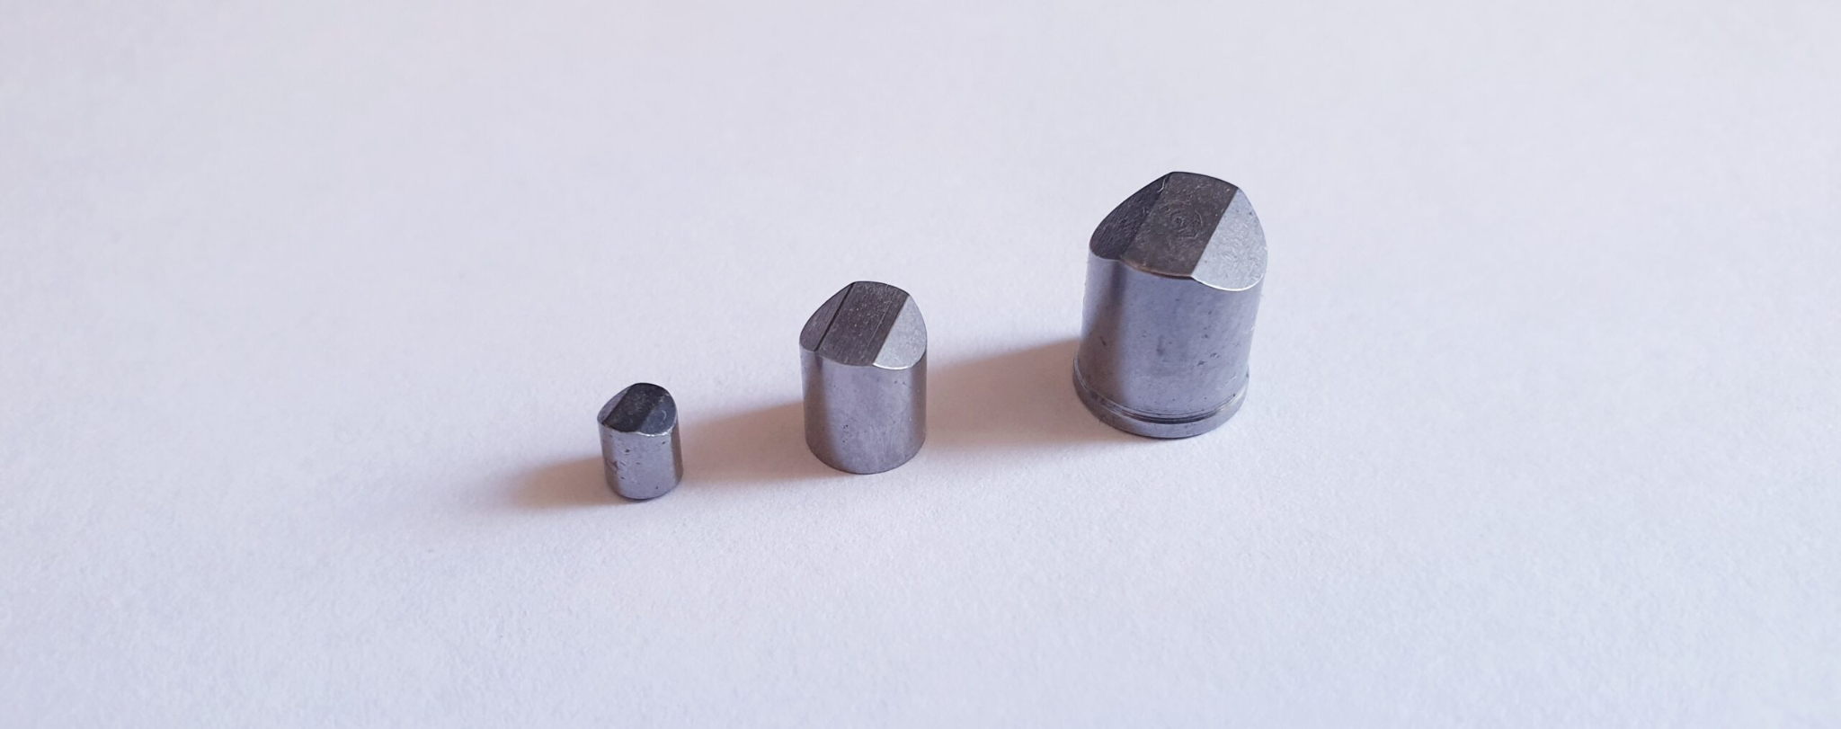
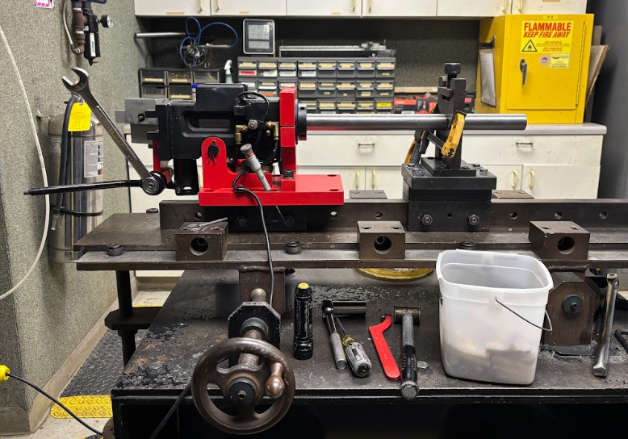
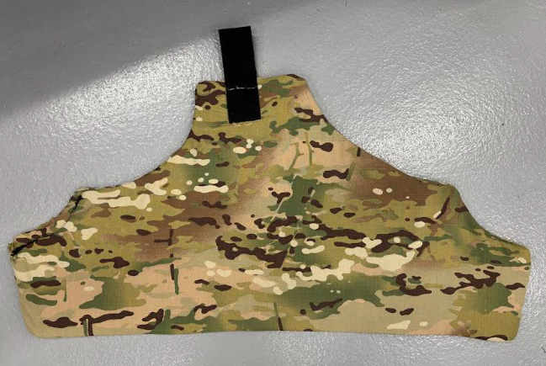
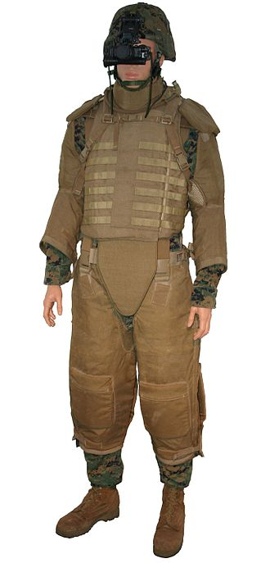
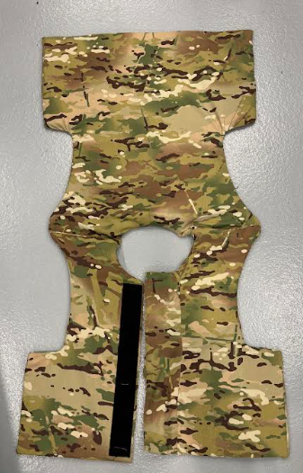
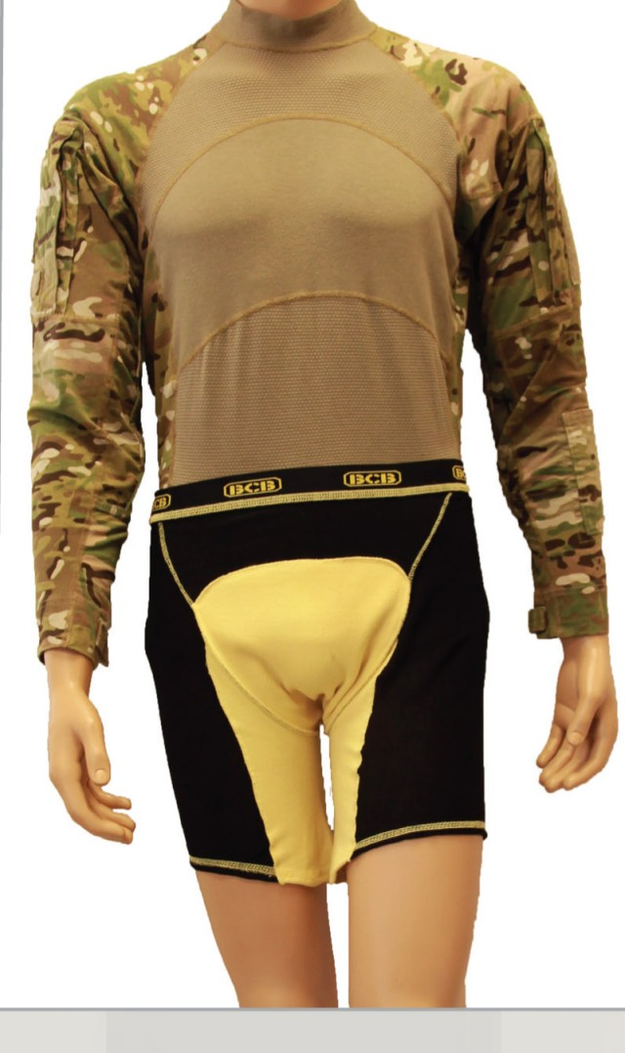
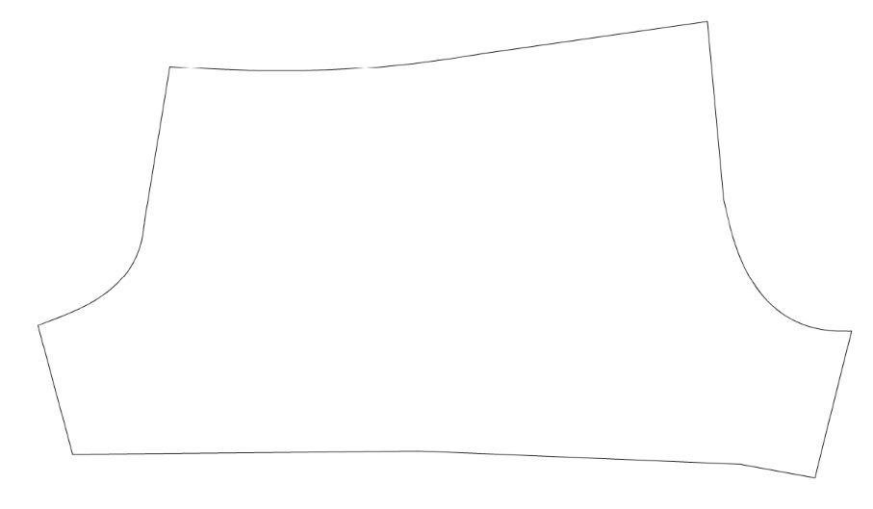
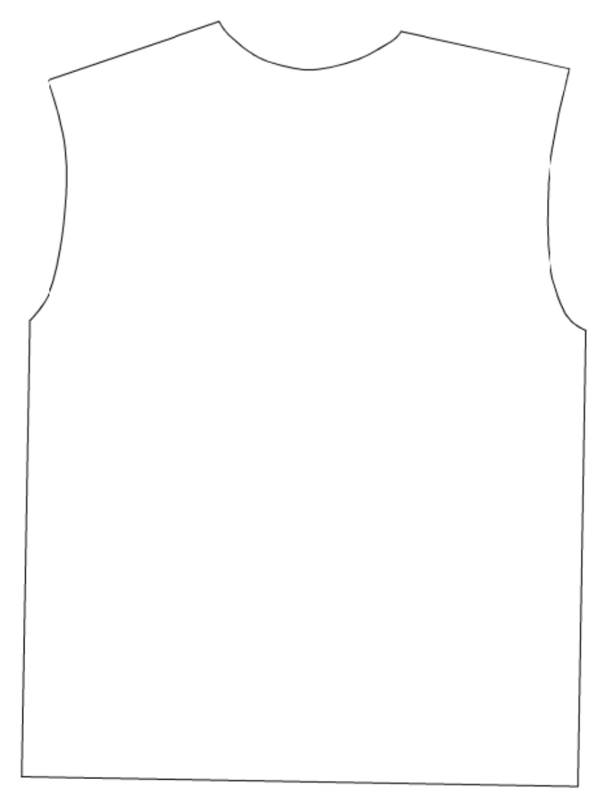
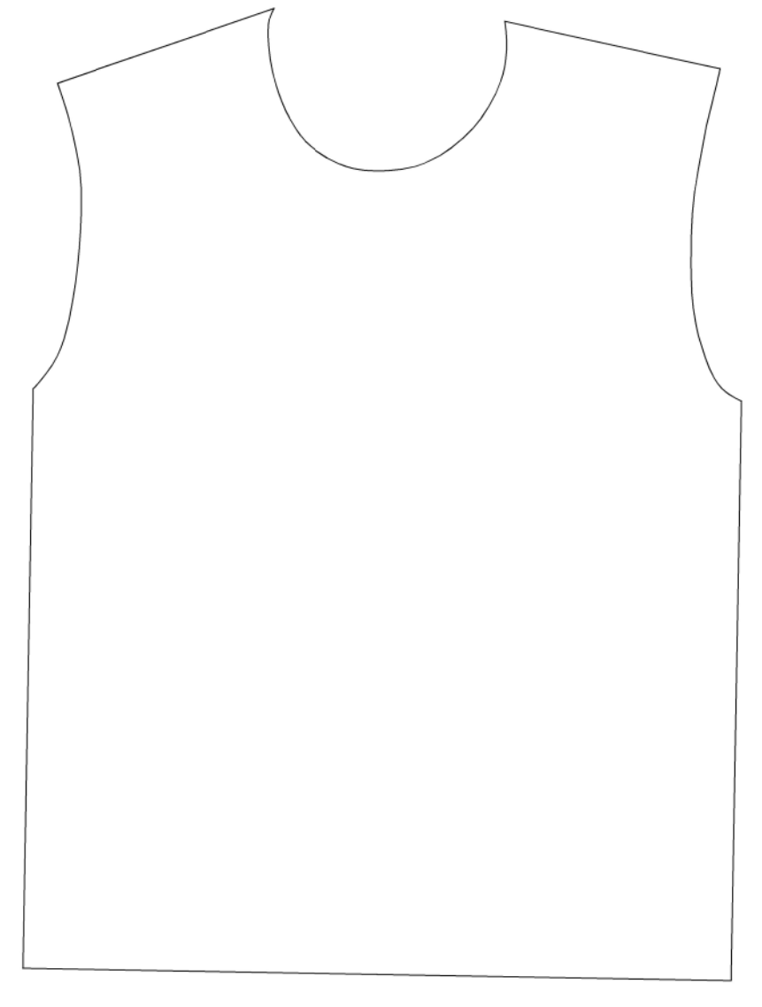
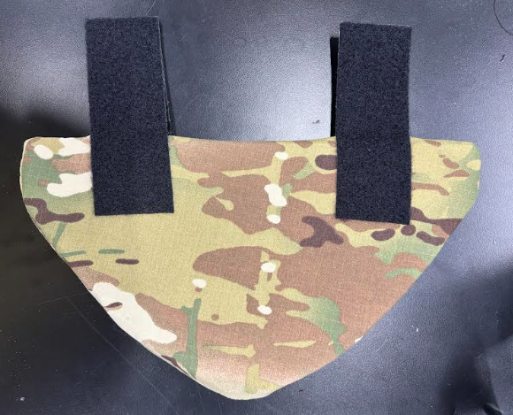
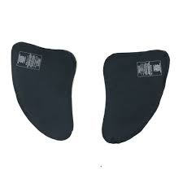



Golden Fleece:
Shrapnel Resistant Soft Armor
Approved for Public Release
PAO # PR2025-2427
MIDN 1/C Hayden Belcher, James Stubbers, Zachary Meyer
Advisor: Prof. Jenelle Piepmeier
United States Naval Academy
Motivation
Procedure
Results
The rise of small drones, rockets, and indirect fire in modern warfare has changed the nature of the armor required to protect personnel on the ground. It is estimated that 90% of the casualties of the Russo-Ukrainian Conflict are due to shrapnel related wounds. Many surviving casualties have major pieces of shrapnel surgically removed, but suffer for the rest of their lives from small shrapnel that would require an invasive surgical procedure.
Discussion with Advanced Materials Engineers determined and identified optimal polyethylene ply, matrix composite material would best suite the project’s cost, flexibility, and protection requirements. Aramid fibers would make it difficult to improve upon related works.
The live grenade test revealed close range, large frag velocities, much higher than anticipated. Test sample A had a 72.5% frag stop rate, with most of the stopped frag having a diameter of ~1-3mm and most of the pass throughs having a diameter of ~3-6mm. This insight was used to tailor the V50 shrapnel test mass and velocities.
Test 1: Direct Fire Round
were shot by a 44 grain direct fire round out of a collegiate rifle. Both trials were easily able to stop the bullet.
Ply matrix composite material layered test sample after being shot by .22 lr
Test 2: Anti-
Personnel Fragmentation Munition
At NRL Blossom Point Test Range, combinations of layers were tested against a anti-personnel fragmentation munition at distances of 5, 10, and 15 ft. The fragment size and velocities were measured using a high-speed camera and penetration holes. The layers were then analyzed for fragmentation stoppages.
Source:Radiopaedia.org
Source:Flipscience.ph
Conclusion
Chest X-Ray of a man present in a warzone with 3mm shrapnel in lower chest.
blast test at 10 ft
The Armor Demand Curve (axes are normalized) predict the velocity where 50% of projectiles pass through the material at a certain material thickness and projectile size . From this curve we are able to predict the velocity and size of projectiles that are able to pierce our armor at any layer count. Test Sample B gave a marginal improvement over Test Sample A at 150% the weight.
The performance of the polyethylene matrix composite material was not as high as hoped, with many large fragments penetrating during our testing, and a lower than desired maximum stopping velocity. Despite that, the material is still highly capable against frag and pistol rounds. The final design is relatively comfortable, lightweight, and modular given the stiffness of the material used. The total system weight was only 12.4 lbs. Future iterations could use more advanced material products, and a more refined manufacturing process to create a fieldable product. The estimated cost of the material for this system is $60/lbm or $750 overall for a men’s large.
Problem Statement
FSPs
Design and produce a lightweight, agile, and modular soft armor under garment that protects SOF operators’ vitals from shrapnel munitions to increase survivability.
Test 3: Shrapnel Simulation
At a Commercial Production Ballistics test facility, Test Samples A and B were tested against 2 different NATO Fragment Simulating Projectiles(FSP) to determine the V50 fragment velocity.
Final Design
Related Works
The original design was cut, tried for fitment and flexibility, then cut again until the designs below were reached. Sample A with a higher number of layers were used because Sample B with a lower number of layers was found ineffective in the blast test, and Sample C with the highest number of layers presented a marginal maximum velocity gain for a 50% increase in weight in comparison.
During GWOT the US Army developed a boxer system known as Protective Under Garment(PUG). The system featured a aramid mesh boxer, and additional thick aramid inserts to be worn around the groin to protect soldiers from IED threats. The system has since been phased out.
FSP test firing apparatus
Designing for Vest and Pant
References
Initial vest and pant designs were drawn from existing patterns. Layers of the polyethylene matrixed material would be put inside an “envelope” of multicam ripstop nylon used for traditional uniforms and then front and rear panels would be attached with a flexible and elastic. The left and right pant would be cut from the same design, and hang independently from a duty belt by Velcro .
[1] Bickle I., Shrapnel in chest. Case study, Radiopaedia.org, 2023 https://doi.org/10.53347/rID-168395
[2] Lopez T., Kevlar underpants' protect pelvic region, February 23, 2012 https://www.army.mil/article/74306/kevlar_underpants_protect_pelvic_region
[3] Dawson, D., Army Defends Interceptor Body Armor as the Best for the Best, Army. mil, 2007, https://www.army.mil/article/3298/army_defends_interceptor _body_armor_as_the_best_for_the_best
[4] Brady C., An Analysis of Wound Statistics in Relation to Personal Ballistic Protection, Australian Government Department of Defence Defence Science and Technology Organisation, 2003,https://apps.dtic.mil/sti/tr/pdf/ADA419442.pdf
Pant design, featuring deepened groin and posterior cuts, and duty belt Velcro attachment. This design created an overlap for a total of 2x layers of matrix composite material over the femoral artery region. 2.6 lbs
Acknowledgement
Source:Worldmilitary.org
The Interceptor Multi-threat Body Armor System was a aramid fabric and ballistic plate system used by the DOD during GWOT. It featured many removable components. The vest, without any plates or additional components weighed 8.4 lbs. The system has since been phased out.
A special thanks to Dave Steenkamer and Brad Grunden at Honeywell Armor for the materials, manufacturing capabilities, and technical advice and testing.
Additional special thanks to Edward Lustig and team at NSWC Indian Head for facilitating live explosive testing and providing high speed footage.
Source:Army.mil
Left and right pant design
Vest back design
Vest front design
Initial testing of these designs revealed flaws in fit and flexibility, so new iterations include deepened arm holes, relief cuts, material removal, a separate groin piece, and adding Velcro and elastic bands.
Vest design featuring deepened arm holes in front and rear, velcro center seal for expedited don and removal. Elastic waist band added to cinch material to body. 6.8 lbs
Groin piece featuring velcro attachment point. 0.4 lbs
Chauncey Broering
Notes:
Do not change: page size, background color, font size or font type.
You may change: the name of the section headings as appropriate (e.g. Method might be Algorithm, Design Approach or Analysis); You may also remove a section if it doesn’t apply (e.g. Acknowledgements)
Tips:
Graphics should be hi res (will be printed large), captioned, and source listed in caption or on graphic if not self generated. Use white outline. Png is a good file format for MatLab plots. Jpg preferred for photos
Plots: make sure fonts for axis labels are readable. Consider adding axis labels or annotations in power point rather than generating software.

