Slide 1


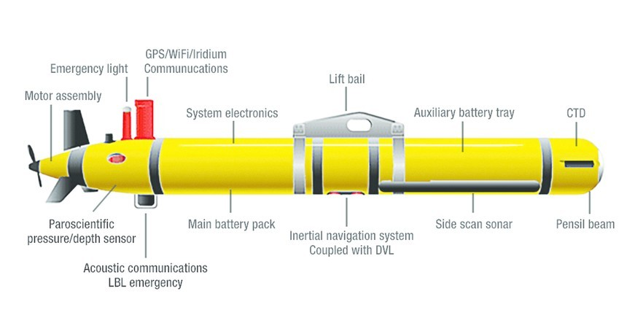
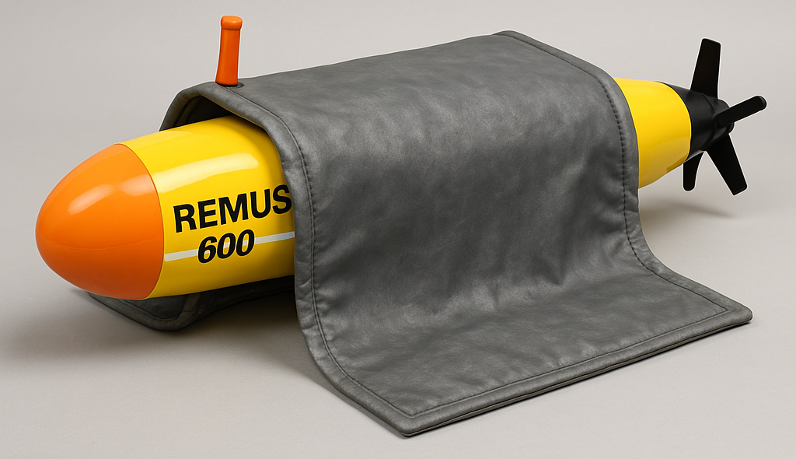
Capstone Poster Tisp
Approved for Public Release
​
PAO # PR2025-2405
Project Nemo: Feasibility of Nuclear a Nuclear Powered UUV
Midshipman 1/C Austin Nolan, Lewis Camp, Eric Tingle, Seth Talbert, and William Schleper
LCDR John Joyce
United States Naval Academy
Background
Remus 600 Platform
Design Constraints/Customer Requirements Snapshot
The undersea domain is critical to U.S. security. Team Lucky Fins is exploring ways to extend the mission duration of the Remus 600 UUV platform used by UUVGRU 1. These autonomous vehicles, valuable for ocean research, offer enhanced potential for military use if operation times could be significantly expanded from a few days to months at a time or longer—protecting our forces and securing the seas whilst at a distance.
Key constraints of Remus platform and radiation limits which must be adhered to:
Internal power demand: 16.2kWh ~230W
Max allowable dose (Navy): 100 mrem/year
RTG size limited by torpedo tube deployability
Shielding requirements critical
Low cost
Design of current Remus 600
MATLAB Modeling Results
Summary: Key Findings
Our MATLAB-based analysis focused on optimizing the Sr-90 RTG system for thermal power output, geometric constraints, and radiation safety. The key outputs of the model are summarized below:
⚙️ RTG Core Design Optimization
Target Thermal Power Output: 230 Watts
Optimized Sr-90 Mass: 367.00 kg
Final Core Radius: 10.92 cm
Core Length: 200.00 cm
🛡 Shielding Analysis
Available Shielding Thickness: 2.00 cm
Required for 99% Attenuation: 20.35 cm
☢️ Radiation Exposure Estimates
Radiation Dose at 1m Distance in water: 48.79 rem/hr
Radiation Shielding Solution
Following 1000 and 2000 series testing, Team Lucky Fins determined that while powering the REMUS 600 UUV with a radioisotope thermoelectric generator (RTG) is feasible, it presents several challenges:
Fuel Selection: Strontium-90 (Sr-90) was chosen for its high energy density and availability.
Power: Our RTG design is capable of 230 watts (0.23 kW) for 70hrs to sustain propulsion and operate onboard sensors and equipment. UUV downtime is 3 days to recharge battery to support another 70hr mission without needing to be recovered.
Volume Limitation: The amount of Sr-90 needed to meet this power demand alone exceeds the internal space available within the UUV.
Shielding Concern: Limited space also reduces the ability to include sufficient radiation shielding, posing safety and integration risks without additional temporary shielding.
It had been determined by testing conclusions that a battery hybrid system is most optimal to obtained the desired results for enhancing the current UUV Remus platform.
A lead “blanket” solution would allow for additional shielding while in storage. The blanket would be expect to attenuate approximately 80% of the incident radiation from the core.
Blanket Measurements:
Weight: 568.23kg
Thickness: 5.05 (Teflon/Al 0.5cm - Lead 5cm)
☢️ Radiation Exposure Estimate with additional shielding: 0.0988 rem/hr
Acknowledgements
References
Special thank you to Howe Industries and
UUVGRU-1
Compendium of Material Composition Data for Radiation Transport Modeling, Rev. 2
REMUS 600 Schematic Drawing, Drawing No. 165225
Approved for Public Release
​
PAO # PR2025-2405

