Slide 1
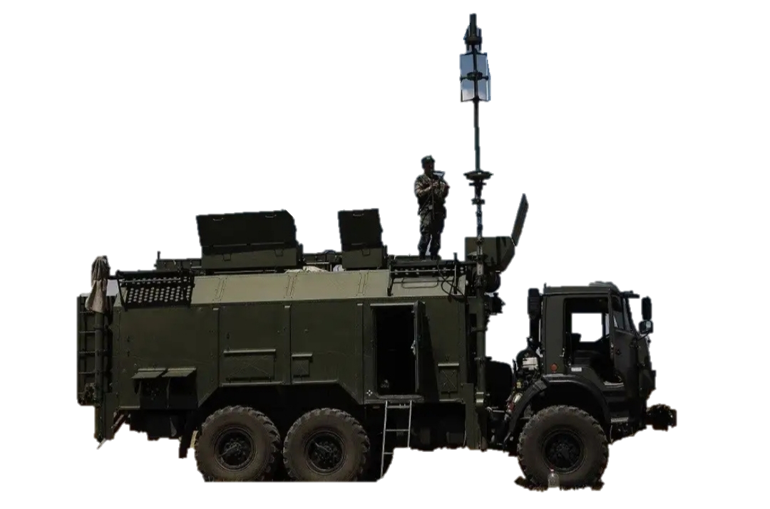
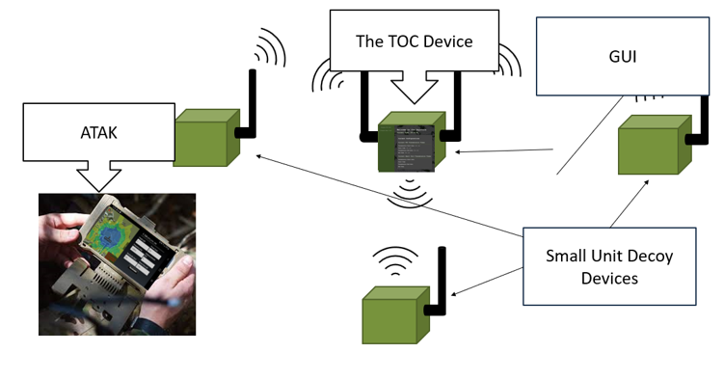
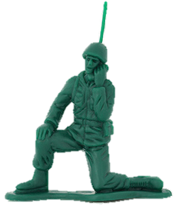
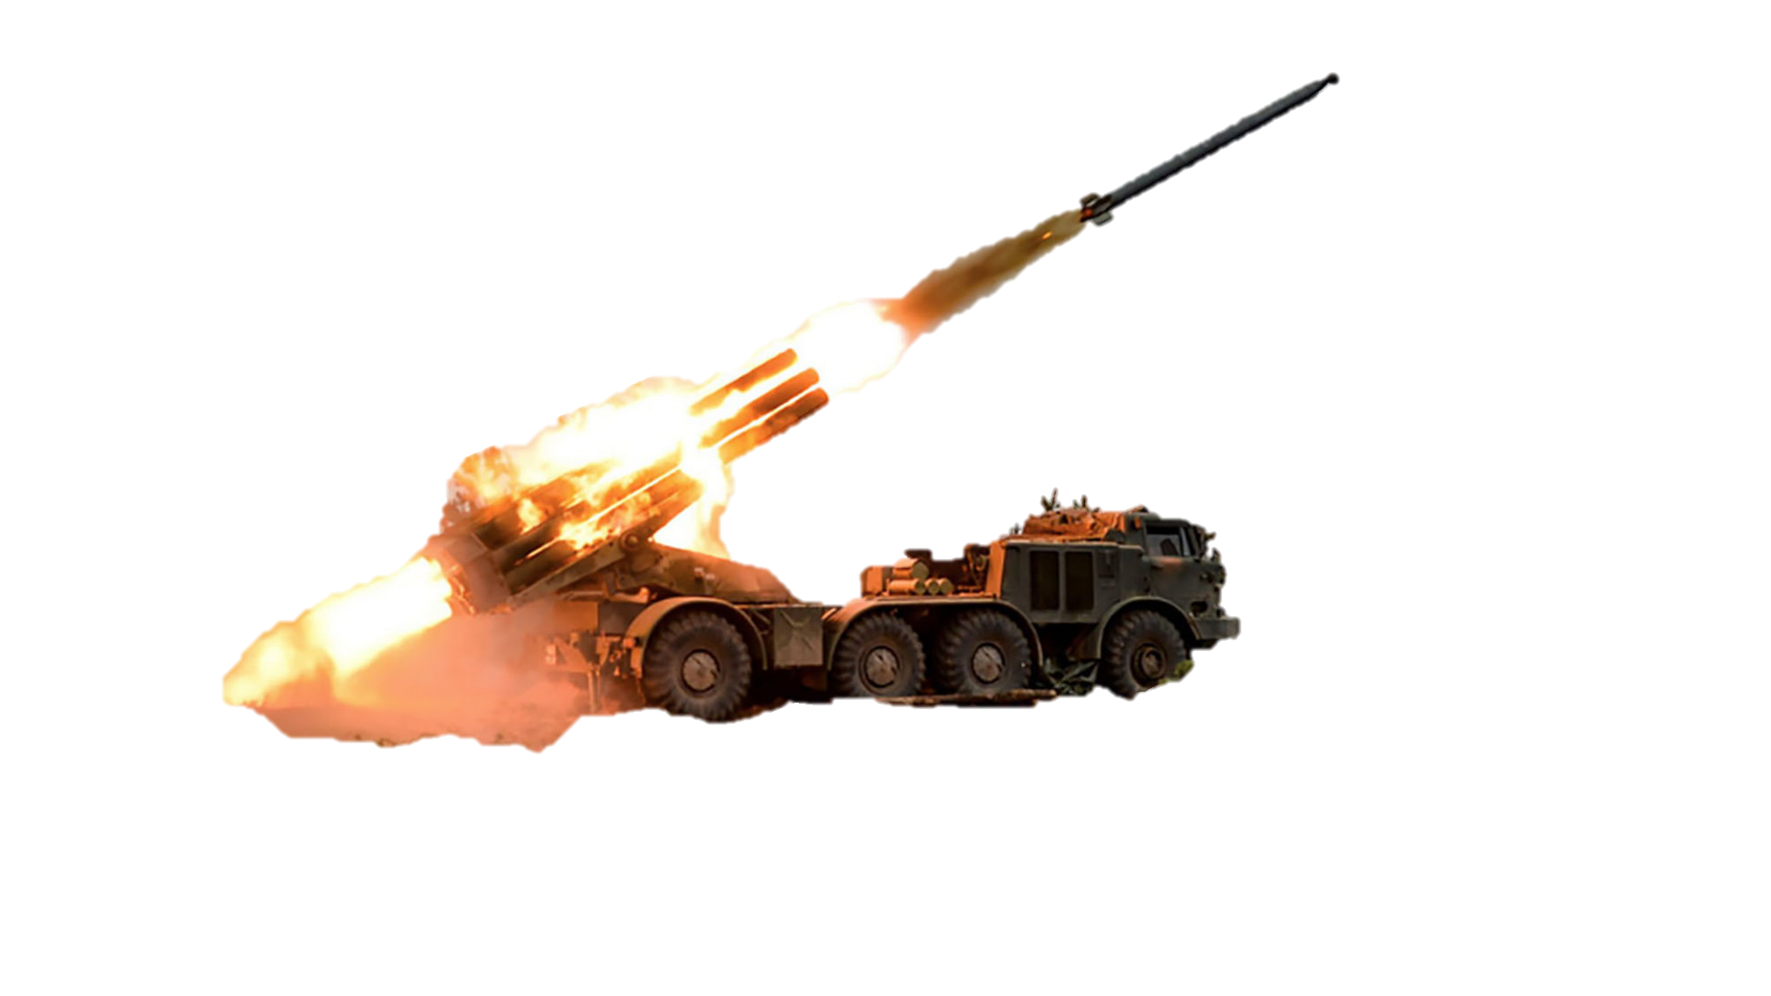
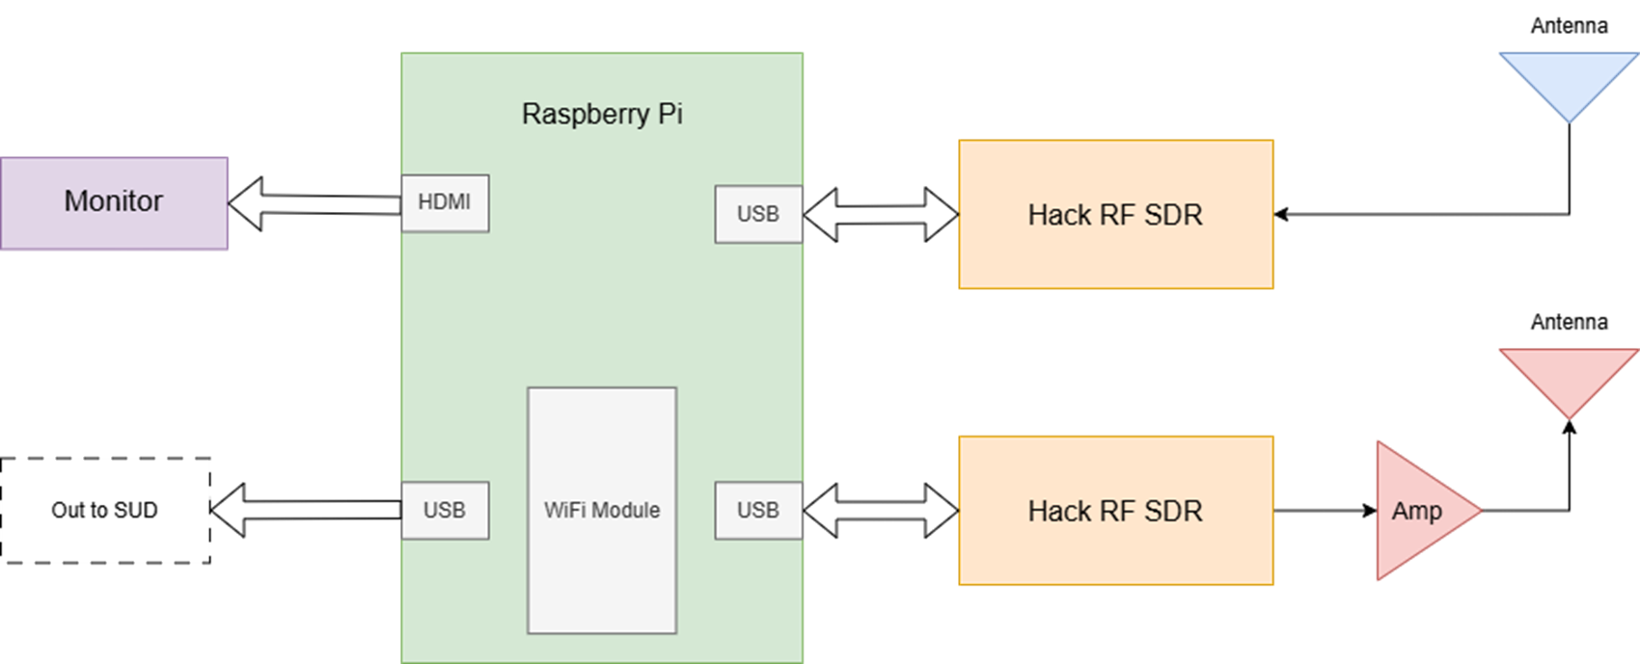
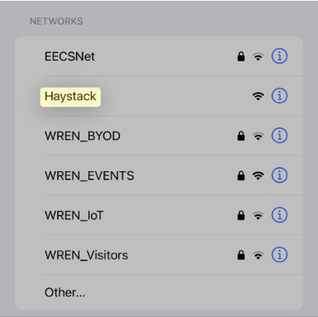
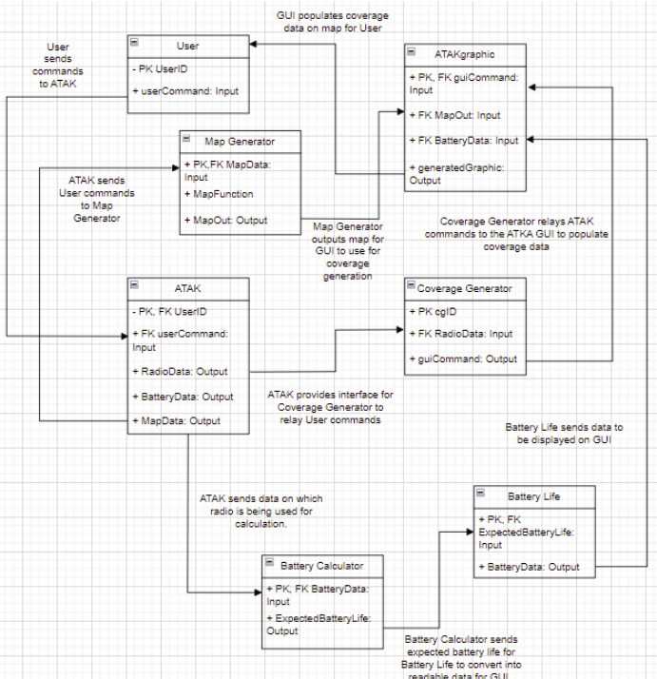
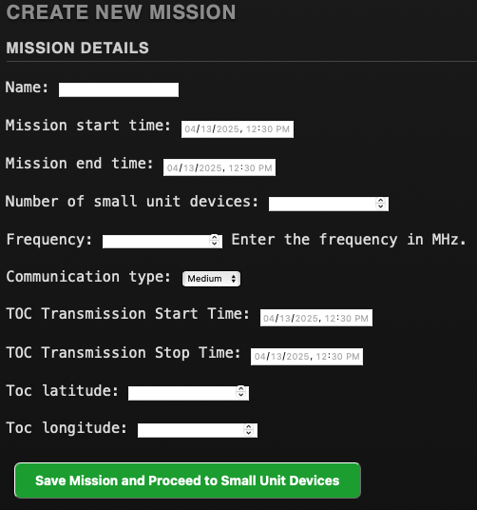
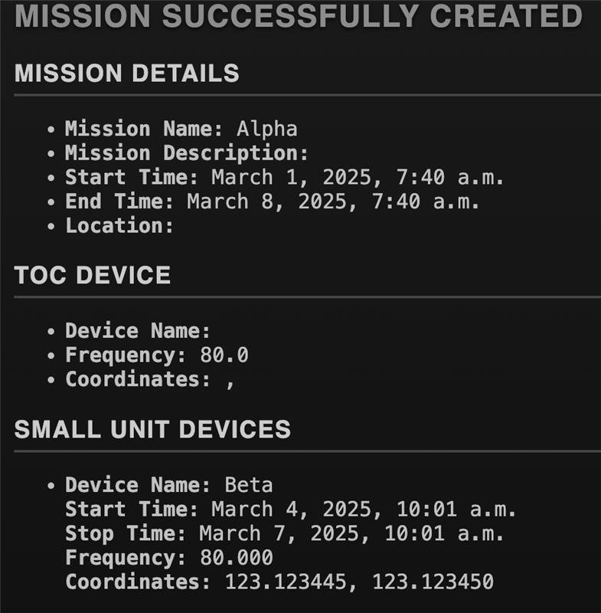
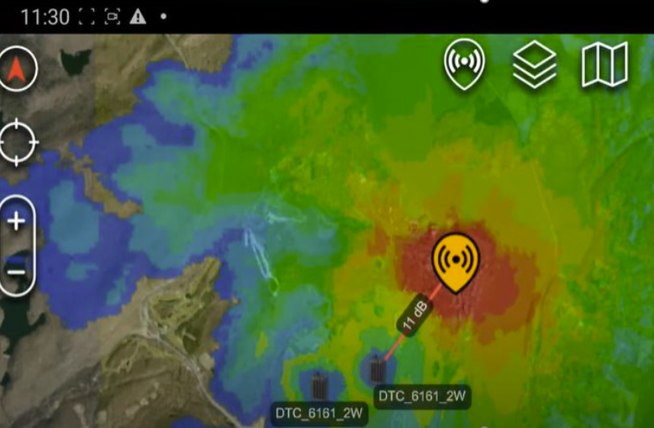
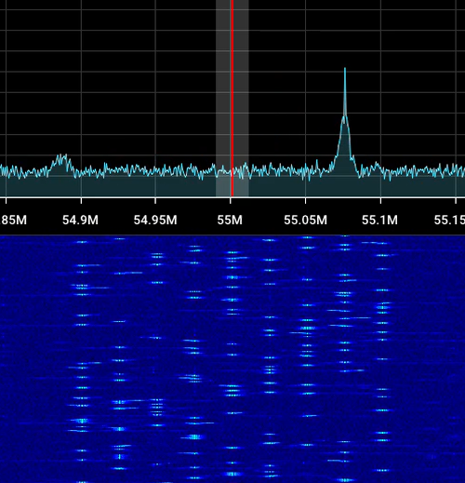
UNITED STATES MILITARY ACADEMY WEST POINT TEAM War Machine Cadets Samuel Della-Santina, Erich Brilliant, Samantha Rose, Kayla Jones, and George Glover Advisors: COL Kirk Ingold and LTC William North
APPROVED FOR PUBLIC RELEASE
PAO # PR2025-2401
HAYSTACK
PROBLEM
SOLUTION
Location Data
Near Peer threats have increased radio direction finding capabilities while friendly reliance on radio communications remains the same
HAYSTACK suite of systems allows the user to plan, synchronize, and integrate electronic warfare effects for force protection of friendly communications
DESIGN OVERVIEW
Small Unit Device:
TOC Device:
User selectable TX frequency range from 47 to 65 MHz
Transmits recorded messages on single channel plain text or FH
User selectable frequency across VHF band of 30 to 300 MHz
5-watt amplifier
ATAK RF Software:
TOC GUI:
Transmits Wi-Fi SSID
User Programmable Locations of Devices
Displays Heat Map of Line-of-sight Projections for each Device accounting for Terrain Features
Displays Salient Characteristics (i.e. Frequency and Battery Life) for each Device
Allows user to plan placement of each transmitter prior to the mission
Allows for user to program TOC and small unit devices with less than one hour of training
CONCLUSION AND FUTURE WORK
HAYSTACK successfully creates a cost-effective and user-friendly system of devices that emulates accurate radio traffic to protect ground forces from radio detection and artillery.
Possible future work avenues include:
Designing a weather-proof enclosure
Linking the radios to the ATAK system
Improving transmission complexity
Higher transmission power
INNOVATION
Small Unit Boards were designed and produced in house to fit the projects needs and reduce cost
TOC and SUD have timing abilities, enabling the user to sequence the entire system together and give the appearance of troop movement
APPROVED FOR PUBLIC RELEASE
PAO # PR2025-2401

